Slide 2
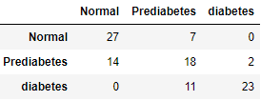
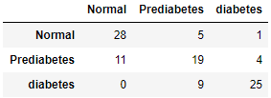
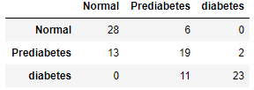
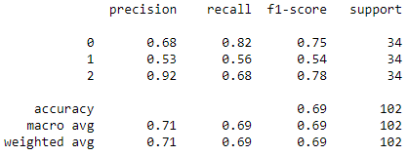
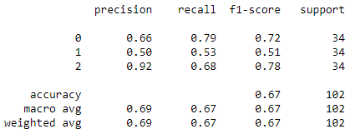
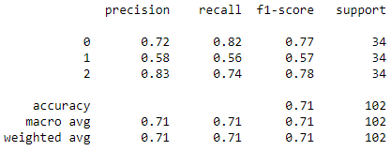
5 Year data – 5 no HBP
RandomForestClassifier
Accuracy = 0.6862745098039216
Accuracy: 0.79 (+/- 0.05)
XGBClassifier
Accuracy = 0.6666666666666666
Accuracy: 0.75 (+/- 0.05) [xgb_model]
SVC
Accuracy = 0.7058823529411765
Accuracy: 0.77 (+/- 0.03)

Slide 3
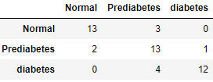
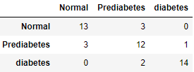
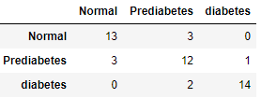
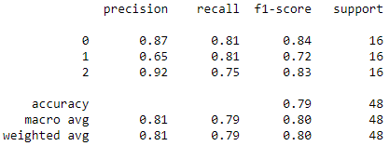
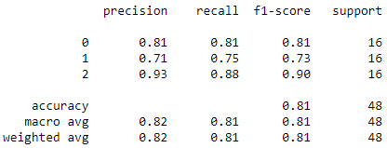
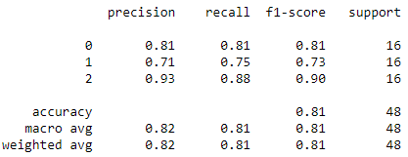
5 Year data – 12 no HBP
RandomForestClassifier
Accuracy = 0.7916666666666666
Accuracy: 0.82 (+/- 0.02)
XGBClassifier
Accuracy = 0.8125
Accuracy: 0.81 (+/- 0.02)
SVC
Accuracy = 0.8125
Accuracy: 0.80 (+/- 0.02)

Slide 4
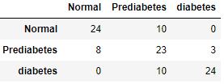
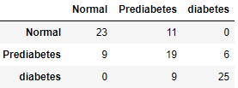
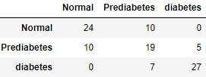
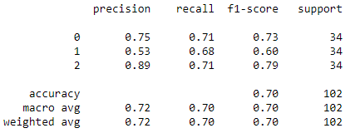
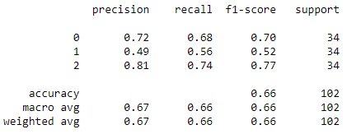
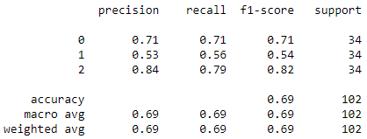
5 Year data – 5 HBP
RandomForestClassifier
Accuracy = 0.696078431372549
Accuracy: 0.78 (+/- 0.05)
XGBClassifier
Accuracy = 0.6568627450980392
Accuracy: 0.74 (+/- 0.05)
SVC
Accuracy = 0.6862745098039216
Accuracy: 0.75 (+/- 0.03)

Slide 5
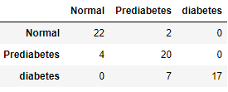
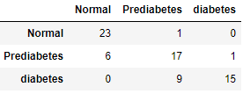
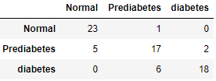
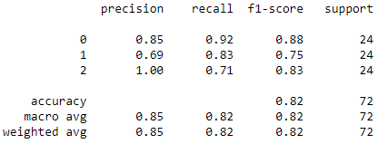
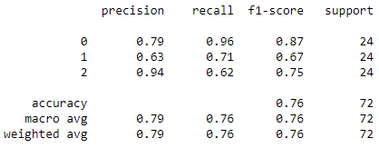
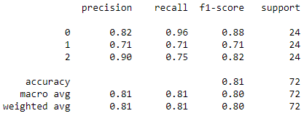
5 Year data – 12 HBP
RandomForestClassifier
Accuracy = 0.8194444444444444
Accuracy: 0.82 (+/- 0.01)
XGBClassifier
Accuracy = 0.7638888888888888
Accuracy: 0.80 (+/- 0.02)
SVC
Accuracy = 0.8055555555555556
Accuracy: 0.78 (+/- 0.01)

Slide 6
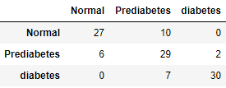
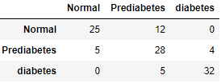
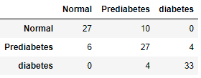
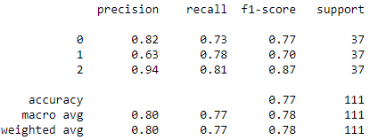
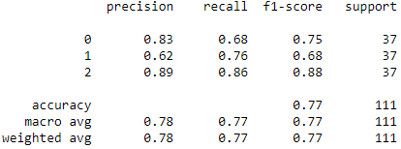
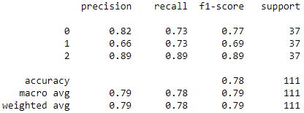
4 Year data – 12 NoHBP
RandomForestClassifier
Accuracy = 0.7747747747747747
Accuracy: 0.81 (+/- 0.01)
XGBClassifier
Accuracy = 0.7657657657657657
Accuracy: 0.80 (+/- 0.01)
SVC
Accuracy = 0.7837837837837838
Accuracy: 0.78 (+/- 0.01)

Slide 7
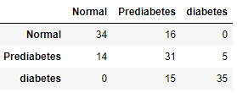
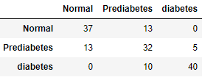
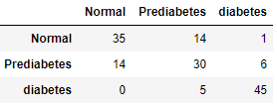
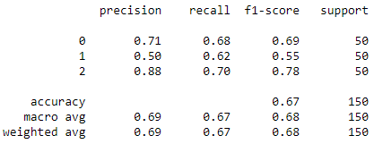
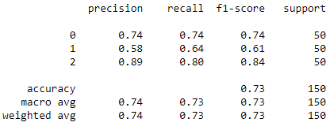
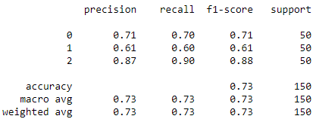
4 Year data – 5 NoHBP
RandomForestClassifier
Accuracy = 0.666
Accuracy: 0.78 (+/- 0.05)
XGBClassifier
Accuracy = 0.7266666666666667
Accuracy: 0.74 (+/- 0.05)
SVC
Accuracy = 0.7333333333333333
Accuracy: 0.75 (+/- 0.03)

Slide 8
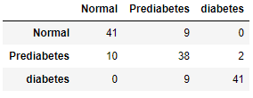
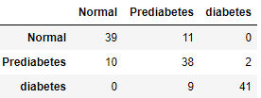
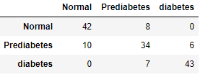
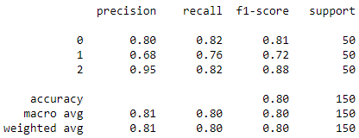
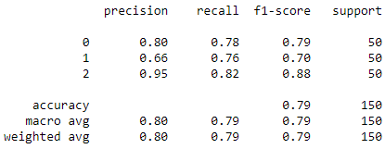
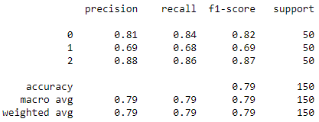
4 Year data – 12 HBP
RandomForestClassifier
Accuracy = 0.8
Accuracy: 0.81 (+/- 0.01)
XGBClassifier
Accuracy = 0.7866666666666666
Accuracy: 0.80 (+/- 0.01)
SVC
Accuracy = 0.7933333333333333
Accuracy: 0.77 (+/- 0.01)

Slide 9
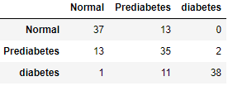
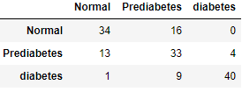
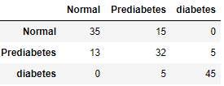
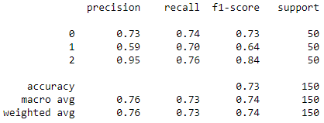
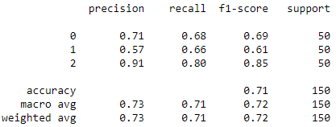
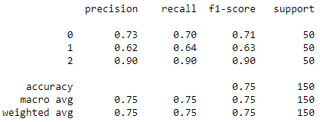
4 Year data – 5 HBP
RandomForestClassifier
Accuracy = 0.7333333333333333
Accuracy: 0.77 (+/- 0.05)
XGBClassifier
Accuracy = 0.7133333333333334
Accuracy: 0.73 (+/- 0.05)
SVC
Accuracy = 0.7466666666666667
Accuracy: 0.75 (+/- 0.03)

Slide 10
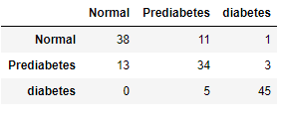
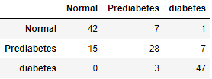




3 Year data – 12 NoHBP
RandomForestClassifier
Accuracy = 0.78
Accuracy: 0.79 (+/- 0.01)
XGBClassifier
Accuracy = 0.78
Accuracy: 0.78 (+/- 0.01)
SVC
Accuracy = 0.78
Accuracy: 0.76 (+/- 0.01)

Slide 11






3 Year data – 5 NoHBP
RandomForestClassifier
Accuracy = 0.7533333333333333
Accuracy: 0.77 (+/- 0.05)
XGBClassifier
Accuracy = 0.7533333333333333
Accuracy: 0.73 (+/- 0.04)
SVC
Accuracy = 0.7733333333333333
Accuracy: 0.75 (+/- 0.03)

Slide 12






3 Year data – 12 HBP
RandomForestClassifier
Accuracy = 0.7333333333333333
Accuracy: 0.79 (+/- 0.01)
XGBClassifier
Accuracy = 0.7133333333333334
Accuracy: 0.78 (+/- 0.01)
SVC
Accuracy = 0.7533333333333333
Accuracy: 0.76 (+/- 0.01)

Slide 13






3 Year data – 5 HBP
RandomForestClassifier
Accuracy = 0.74
Accuracy: 0.77 (+/- 0.05)
XGBClassifier
Accuracy = 0.7266666666666667
Accuracy: 0.72 (+/- 0.05)
SVC
Accuracy = 0.7266666666666667
Accuracy: 0.74 (+/- 0.03)

Slide 14






2 Year data – 12 NoHBP
RandomForestClassifier
Accuracy = 0.7333333333333333
Accuracy: 0.75 (+/- 0.04)
XGBClassifier
Accuracy = 0.735
Accuracy: 0.71 (+/- 0.04)
SVC
Accuracy = 0.735
Accuracy: 0.72 (+/- 0.03)

Slide 15






2 Year data – 5 NoHBP
RandomForestClassifier
Accuracy = 0.735
Accuracy: 0.74 (+/- 0.04)
XGBClassifier
Accuracy = 0.7233333333333334
Accuracy: 0.70 (+/- 0.04)
SVC
Accuracy = 0.73
Accuracy: 0.71 (+/- 0.02)

Slide 16






2 Year data – 5 HBP
RandomForestClassifier
Accuracy = 0.72
Accuracy: 0.74 (+/- 0.04)
XGBClassifier
Accuracy = 0.7216666666666667
Accuracy: 0.70 (+/- 0.04)
SVC
Accuracy = 0.7183333333333334
Accuracy: 0.71 (+/- 0.03)

Slide 17






2 Year data – 12 HBP
RandomForestClassifier
Accuracy = 0.6983333333333334
Accuracy: 0.75 (+/- 0.04)
XGBClassifier
Accuracy = 0.7
Accuracy: 0.72 (+/- 0.04)
SVC
Accuracy = 0.7116666666666667
Accuracy: 0.73 (+/- 0.03)

